Slide 1
FSCI Presents:
Wet Chemical Kitchen Suppression System Inspections

Slide 2
SYSTEM INFORMATION
The system being reviewed is designed per: | IBC – 2015
 | IFC – 2015
 | IMC – 2015
 | NFPA 17A – 2013
 | NFPA 10 – 2013
Number of protected hoods: | Two
System manufacturer: | Ansul
Number of systems: | One
Number of agent tanks per system: | Two
Size of agent tanks: | 3 gallons / 3 gallons
Allowable number of flow points per tank: | 11 / 11
Number of flow points used per tank: | 9 / 11
Allowable number of flow points per system: | 22
Total number of flow points used per system: | 20
Manual pull station provided: | Yes
Gas valve provided: | Yes
Adequate placement of detectors: | Yes
Verify plan review letter specifics
Codes used
Number of Hoods
Manufacturer
Size and Number of Tanks
Total Flow points allowed and used

Slide 3
Verify plan review letter specifics
Hood sizes
Nozzle manufacturer, type and numbers
Appliance to be protected
Nozzle locations
HOOD #1 INFORMATION
Hood size: | 9' - 0" x 2' - 9"
Plenum nozzle type: | 1N
Plenum nozzle maximum coverage area: | 10' - 0"
Exhaust duct size: | 10" x 17"
Exhaust duct perimeter: | 54"
Exhaust duct nozzle type: | 2W
Exhaust duct nozzle maximum perimeter: | 100"
APPLIANCE INFORMATION
Type of appliance: | Griddle
Overall appliance size: | Not specified
Hazard area: | 36" x 24"
Nozzle type shown on plans: | 260
Nozzle location related to hazard area: | 0" - 2" inside hazard area perimeter
Nozzle aim point: | Center of hazard area
Nozzle height above hazard: | 30" to 50"
Nozzle maximum coverage area: | 48" x 30"
Shown or provided with a back shelf: | No

Slide 4
Appliances must match the design drawings:
Completely under the hood
Appliances in correct location

Slide 5
Appliances locations must match the design drawings:
Appliance on solid legs
Appliances on wheels must be secured in place
Notes:
Movable appliances must have cable restraints, channel or guide to insure appliances go back to the correct position after cleaning and maintenance.

Slide 6
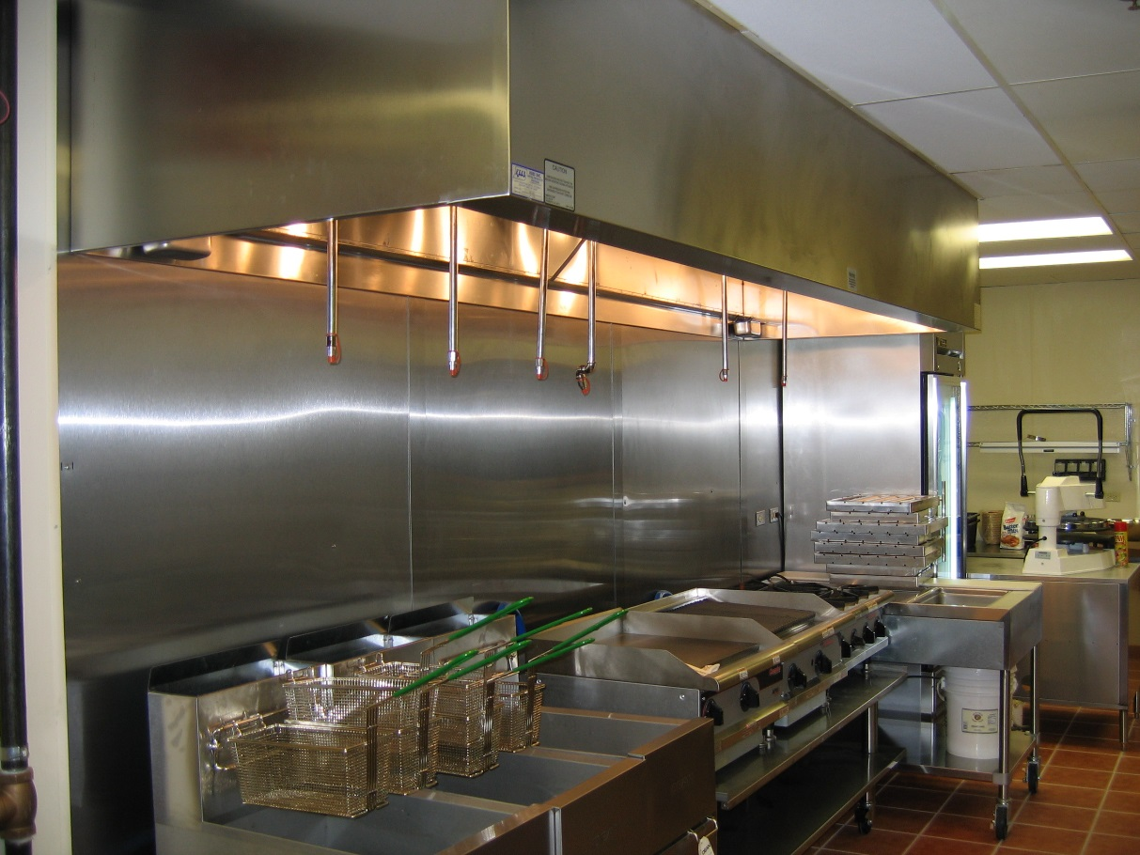
Separation of fryers and surface flame appliances:
All deep fat fryers must be separated from surface flame by 16” space
If a steel or tempered glass baffle is used instead of separation, minimum 8” height between adjacent appliance.
If the fryer and surface flames appliance are on different horizontal planes a minimum of 8” is measured from the higher of the two
Notes:
The baffle is removable, after the acceptance test the baffle will be lost or removed. Its best separate those appliances
with a table or griddle

Slide 7
Verify nozzles:
Verify nozzles installed match those on the plans and letter
Notes:
Marking on the nozzles are very difficult to see

Slide 8
Verify nozzles:
Verify nozzle locations, heights and aim points match those on the plan review letter
Notes:
Heights are dictated by the type of nozzle and appliance, aim point is normally center of hazard being protected

Slide 9
Tanks and manifolds
Check tanks size to plan review letter
Manifold actuation lines required for simultaneous activation

Slide 10
System Piping
All pipe installed must be stainless or steel
Galvanized pipe is not allowed

Slide 11
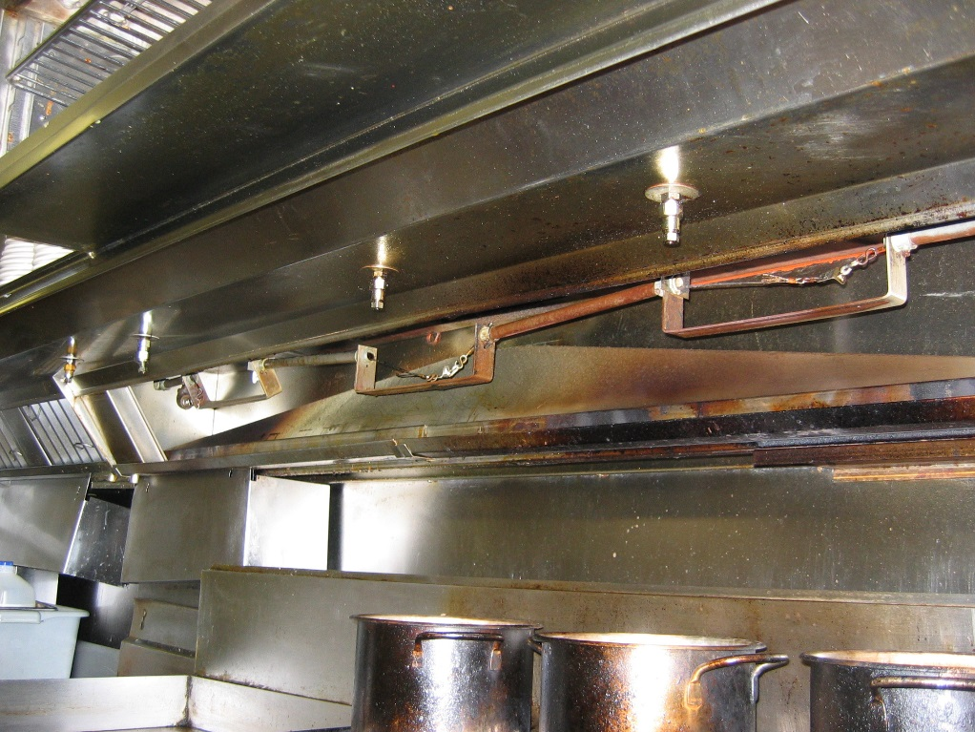
Fusible links are installed at proper locations:
Above each appliance
At top of hood to vertical ducts

Slide 12
Fusible Links Installed:
Above Each Cooking Appliance
Exception:
Not if appliances are located directly below exhaust
At Each Exhaust Duct
Proper Temperature Rating Based on Appliance

Slide 13
Gas and electric must shut down upon activation :
All sources of fuel and power to equipment under the hood must shut down.
Notes:
Solid fuel cooking operations shall not be required to shut down.

Slide 14
Manual System Activation must be:
Clearly Labeled
Mounted 42”- 48” Off Floor
Located 10’ to 20’ Away in Direction of Exit
Activate with a maximum 40 pounds of force
Maximum 14 inches of Movement

Slide 15
Prefer balloons: for each nozzle, to verify pipes are connected and/or nozzle blocked grease

Slide 16
When the system is activated:
Exhaust Fans Should Continue to Operate upon System Activation
Make-up Air Located Outside the Hood does not need to Shut Down
Balloons Should Fill Equally
Alarm Should Activate
Gas / Electric Shut Down

Slide 17
If system is connected to the building fire alarm system:
Verify Notification Devices Activate
Verify Panel Zoned for Kitchen Hood
May Only be a Local Alarm

Slide 18
Approved signs are required to be installed
Often Missed by the Installer

Slide 19
Portable extinguisher requirements:
K-Class Wet Chemical
30’ from Protected Hood
Filled with Proper Agent
Mounted in Area not Prone to being Blocked or Hidden
Current Tag

Slide 20
Mechanical system related items:
Although this is the wet chemical inspection, check it anyway.
Fan Interlocks
(Automatic Fan Operation)
Cable Restraints
Roller Guides

Slide 21
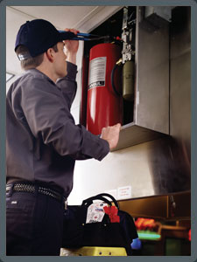
Completing the Inspection
Have Technician Place System in Service
Advise Technician to Place Alarm In Service

Slide 22
Completing the Inspection
Collect As-Built

Slide 23
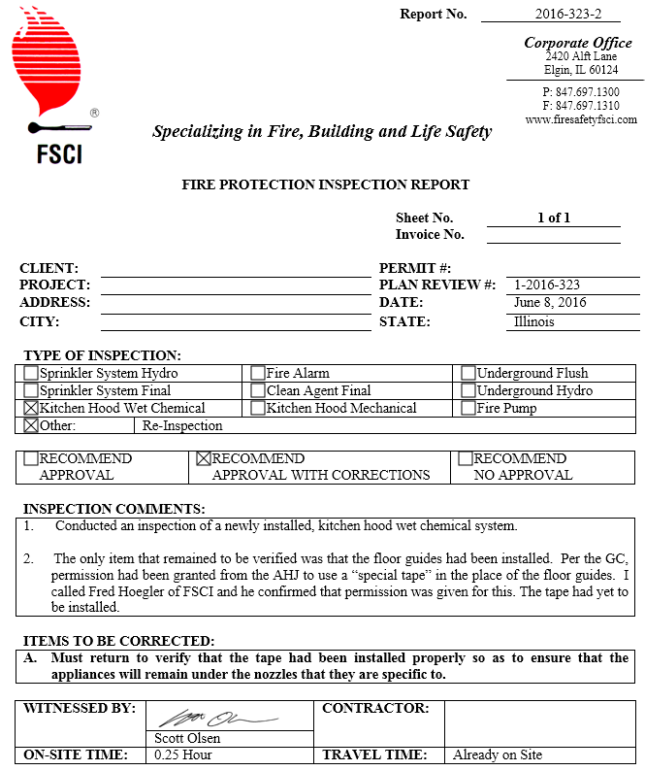
Completing the Inspection
Explain Any Issues or Problems
Complete Report

